Slide 1
Introduction to Web Technologies
All not covered in the previous 5 slides
Lecturer: Christen Cao

Slide 2
Content
17 Tested Elements
Use of CSS and JS
3 Exercises

Slide 3
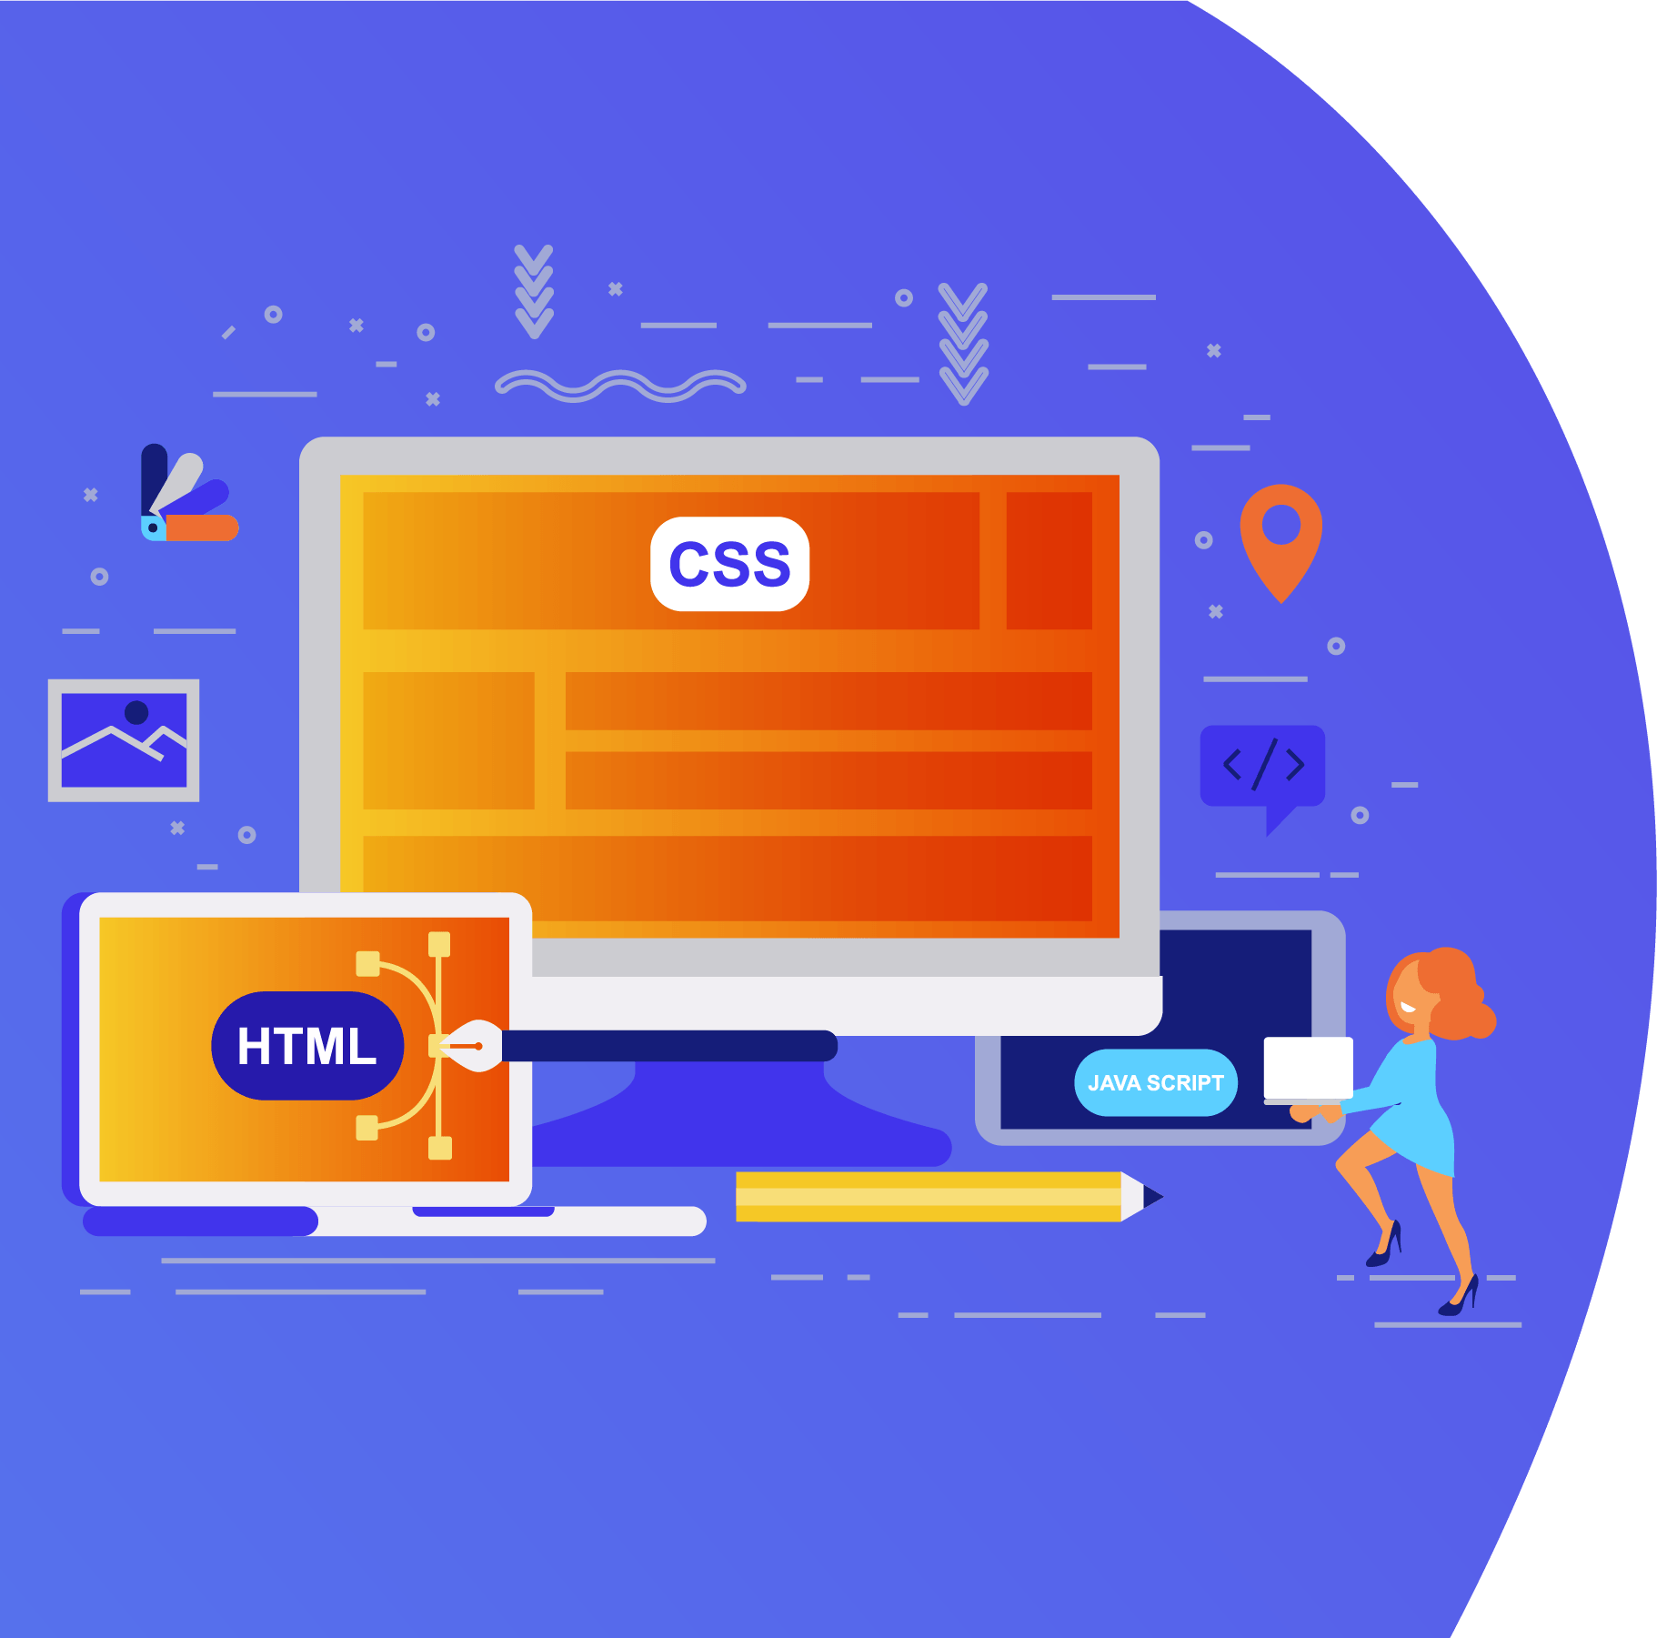
Topic 1: 17 Tested Elements

Slide 4
Basic HTML Tags
HTML is a fairly straightforward programming language. Each tag starts with a “<“ and ends with a “>”
For example the paragraph tag is <p>
There is a range of HTML tags, they help you to design your web page. There are four required tags in HTML. These are html, title, head and body. The table below shows you the opening and closing tag, a description and an example.
Notes:
https://www.cs.kent.ac.uk/teaching/10/modules/CO/3/32/FIT_Chapters/Chapter04/BasicHTMLTags.html

Slide 5
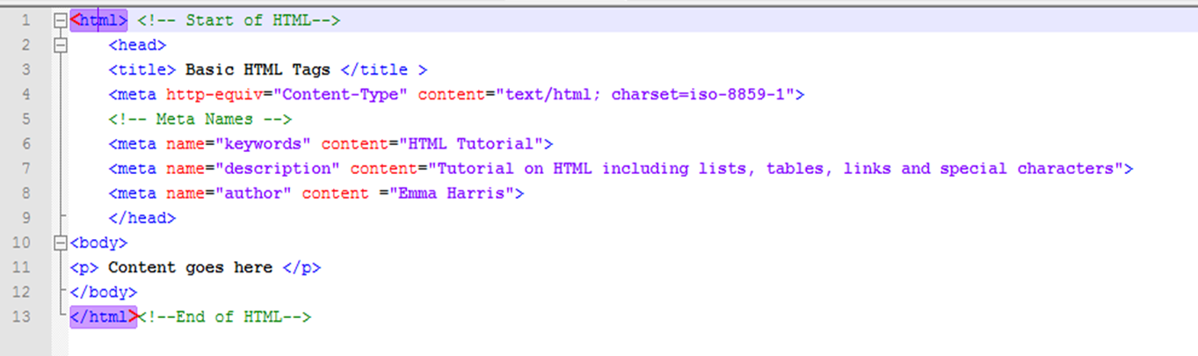
<html></html>
Start HTML Tag | End HTML Tag | Description
<html> | </html> | These are the tags you put at the beginning and end of an HTML file.
Example

Slide 6
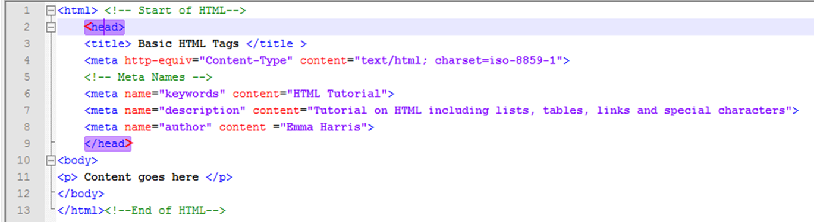
<head></head>
Start HTML Tag | End HTML Tag | Description
<head> | </head> | This includes information including title, meta tags, content type, links to external pages like CSS and JavaScript.
Example

Slide 7
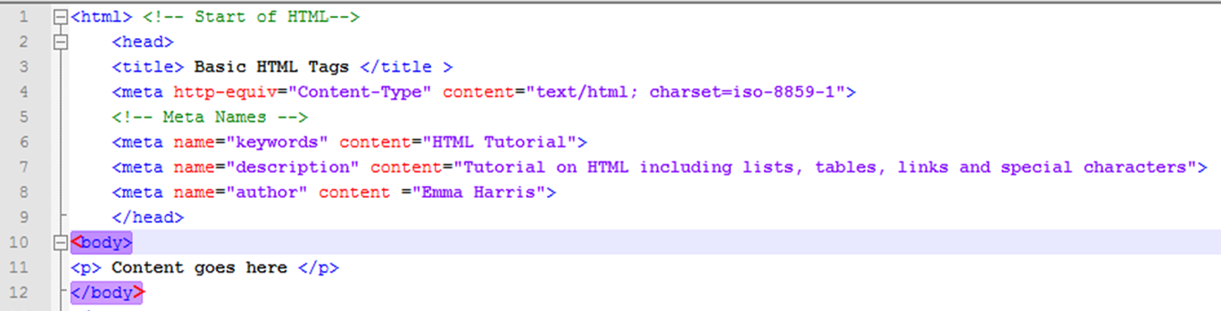
<body></body>
Start HTML Tag | End HTML Tag | Description
<body> | </body> | This contains the contents of the document
Example

Slide 8
<p>, <h1>, <h2>, … <h6>
Open tag | Close tag | Description | Example
<p> | </p> | This tag allows you to create paragraphs | My name is Fred. I live in Medway
<h1> | </h1> | This is the largest heading | Heading 1
<h2> | </h2> | This is second biggest heading | Heading 2
<h3> | </h3> | This is the next heading | Heading 3
<h4> | </h4> | This is another heading | Heading 4
<h5> | </h5> | This is the second smallest heading | Heading 5
<h6> | </h6> | This is the smallest heading | Heading 6

Slide 9
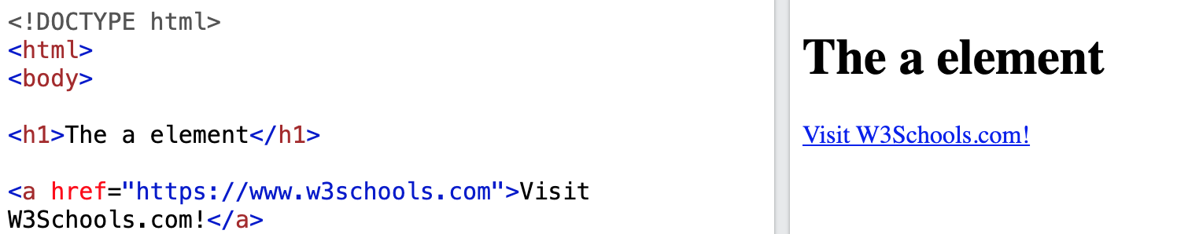
<a></a>
The <a> tag defines a hyperlink, which is used to link from one page to another.
The most important attribute of the <a> element is the href attribute, which indicates the link's destination.
By default, links will appear as follows in all browsers:
An unvisited link is underlined and blue
A visited link is underlined and purple
An active link is underlined and red

Slide 10
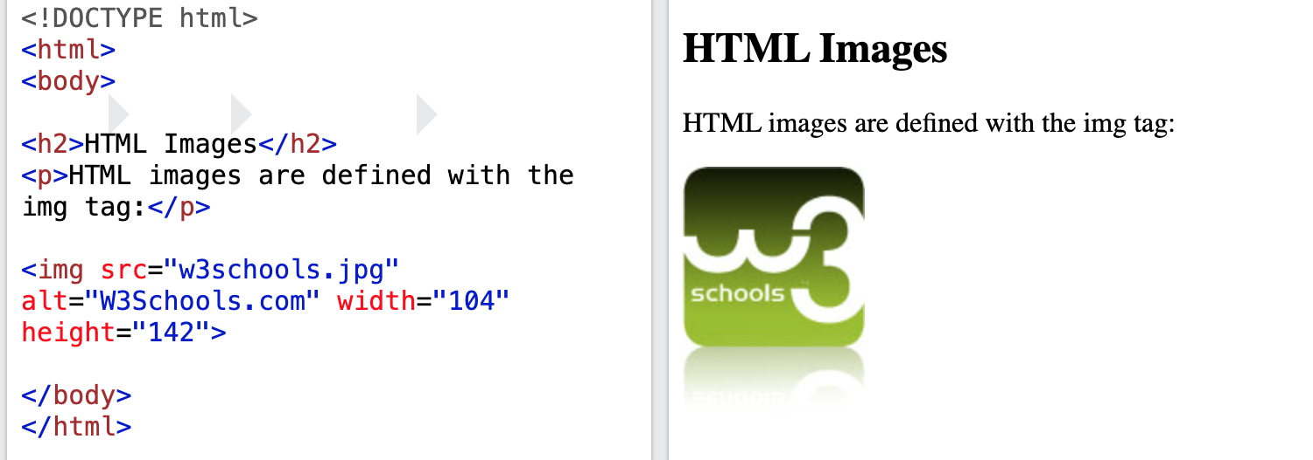
<img>
HTML images are defined with the <img> tag.
The source file (src), alternative text (alt), width, and height are provided as attributes:

Slide 11
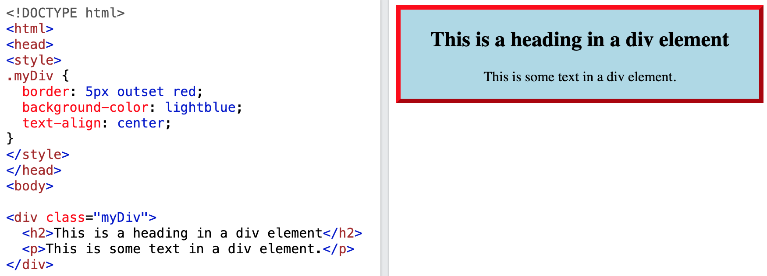
<div></div>
The <div> tag defines a division or a section in an HTML document.
The <div> tag is used as a container for HTML elements - which is then styled with CSS or manipulated with JavaScript.
The <div> tag is easily styled by using the class or id attribute.
Any sort of content can be put inside the <div> tag!

Slide 12
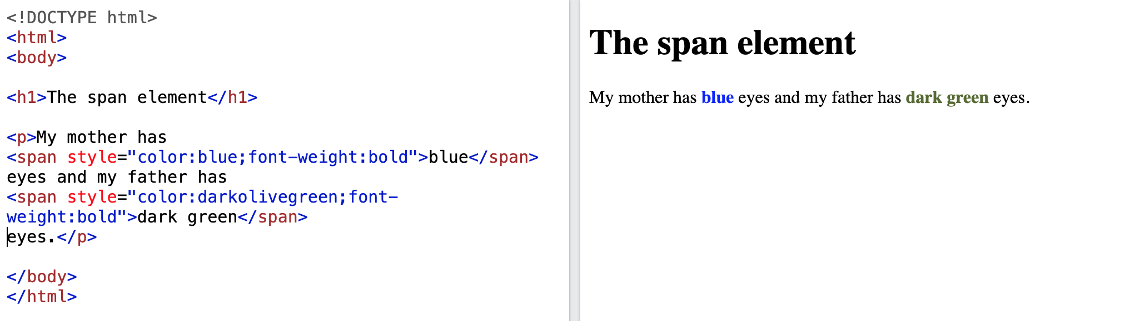
<span></span>
The <span> tag is an inline container used to mark up a part of a text, or a part of a document.
The <span> tag is much like the <div> element, but <div> is a block-level element and <span> is an inline element.

Slide 13
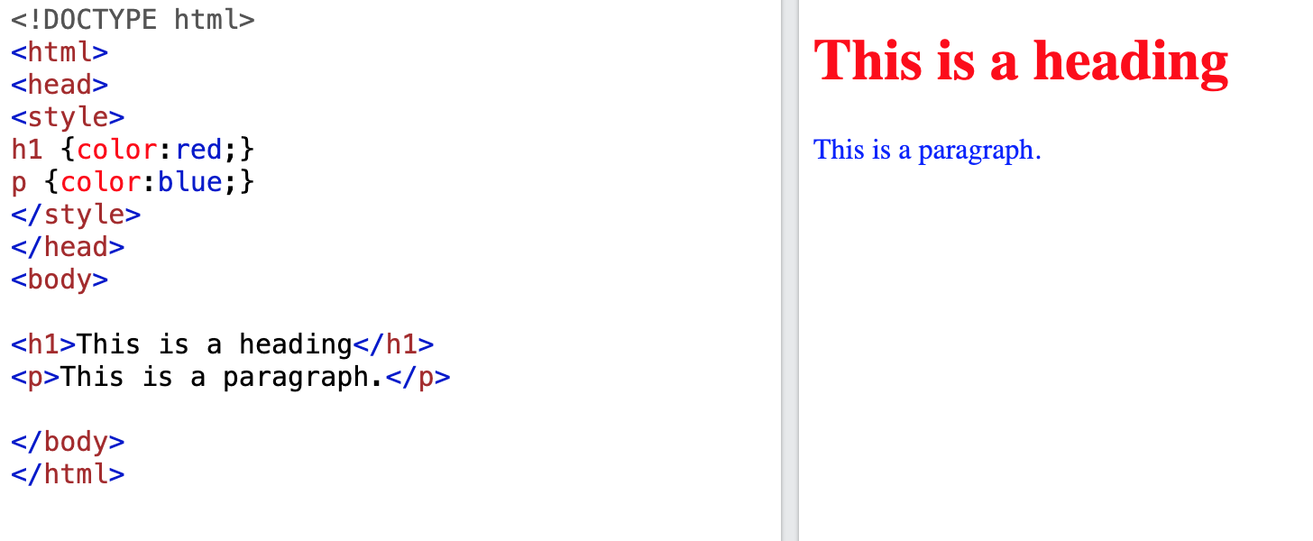
<style></style>
The <style> tag is used to define style information (CSS) for a document.
Inside the <style> element you specify how HTML elements should render in a browser.

Slide 14
CSS Selector
3 common CSS selectors:
Element / Type Selector
Class Selector
ID Selector
There are also element-specific and descendent selectors which allow us to be more precise
Naming Conventions
no whitespace or special characters - case-sensitive
do not start with numbers

Slide 15
Element / Type Selector
Target elements by the element type
Example:
target all <div> elements using a type selector of div
CSS
div { ... }
HTML
<div>...</div>
<div>...</div>

Slide 16
Class Selector
Select an element based on the element’s class attribute value
a little more specific than type selectors
select particular elements rather than all elements of a type
apply the same styles to different elements by using the same class attribute value
Denoted by a leading period ., followed by the class attribute value
CSS
.awesome { ... }
HTML
<div class="awesome">...</div> <p class="awesome">...</p>

Slide 17
ID Selector
Target only one unique element at a time
even more precise than class selectors
use an element’s id attribute value as a selector
id attribute values can only be used once per page
should be reserved for significant elements
Denoted by a leading hash sign #, followed by the id attribute value
CSS
#wrapper { ... }
HTML
<div id="wrapper">...</div>

Slide 18
<style></style>
The <style> tag is used to define style information (CSS) for a document.
Inside the <style> element you specify how HTML elements should render in a browser.

Slide 19
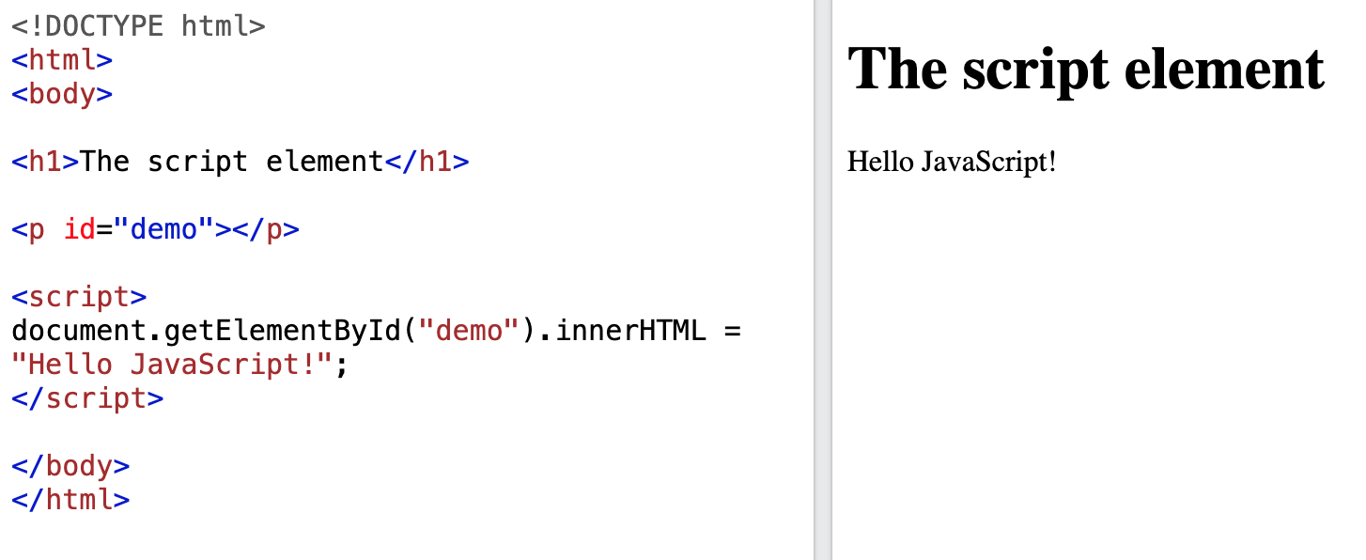
<script></script>
The <script> tag is used to embed a client-side script (JavaScript).
The <script> element either contains scripting statements, or it points to an external script file through the src attribute.
Common uses for JavaScript are image manipulation, form validation, and dynamic changes of content.

Slide 20
Topic 2: Use of CSS and JS

Slide 21
Use of font color attribute (CSS)
Text Color
The color property is used to set the color of the text. The color is specified by:
a color name - like "red"
a HEX value - like "#ff0000"
an RGB value - like "rgb(255,0,0)”
h1 {
text-align: center;
text-transform: uppercase;
color: #4CAF50;
}

Slide 22
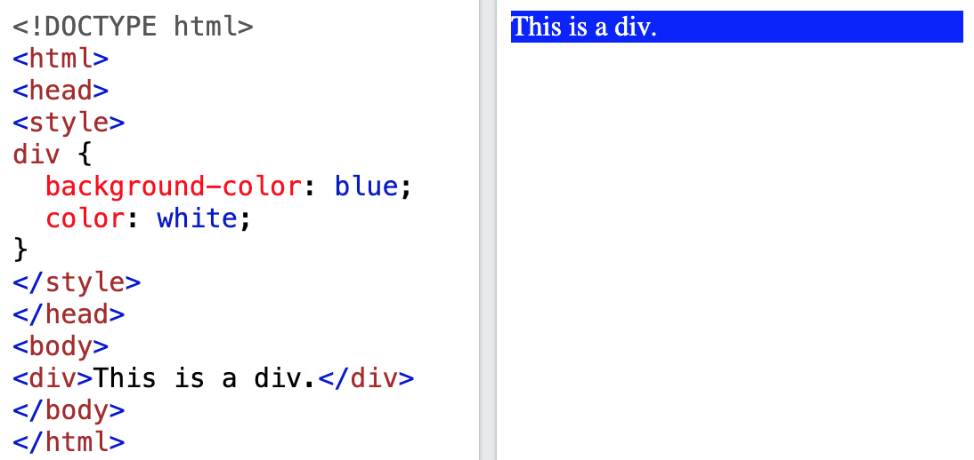
Use of background color attribute (CSS)
The background-color property sets the background color of an element.
The background of an element is the total size of the element, including padding and border (but not the margin).
Tip: Use a background color and a text color that makes the text easy to read.

Slide 23
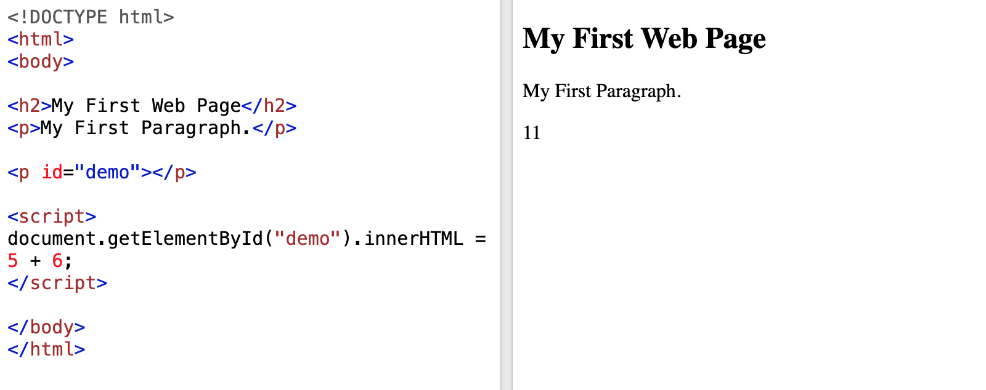
Use of .innerHTML (JS)

Slide 24
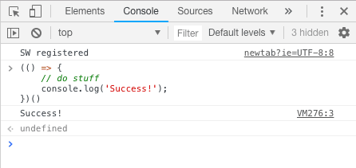
Use of console.log() (JS)
The log() method writes (logs) a message to the console.
The log() method is useful for testing purposes.
let x = 1
console.log(x)
console.log(“Success!”)

Slide 25
Topic 3: Exercises

Slide 26
HTML Exercise

Slide 27
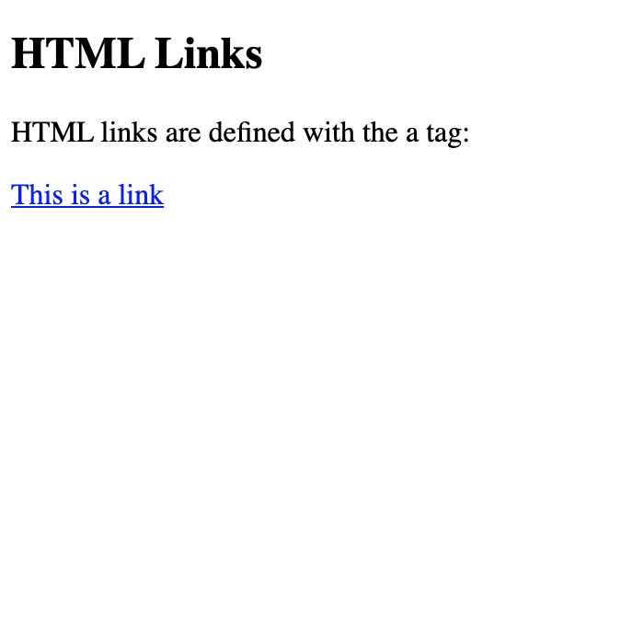

Code this webpage using HTML!
Please use the following tags:
<html>
<body>
<h1>
<p>
<a>
<img>

Slide 28
CSS Exercise

Slide 29
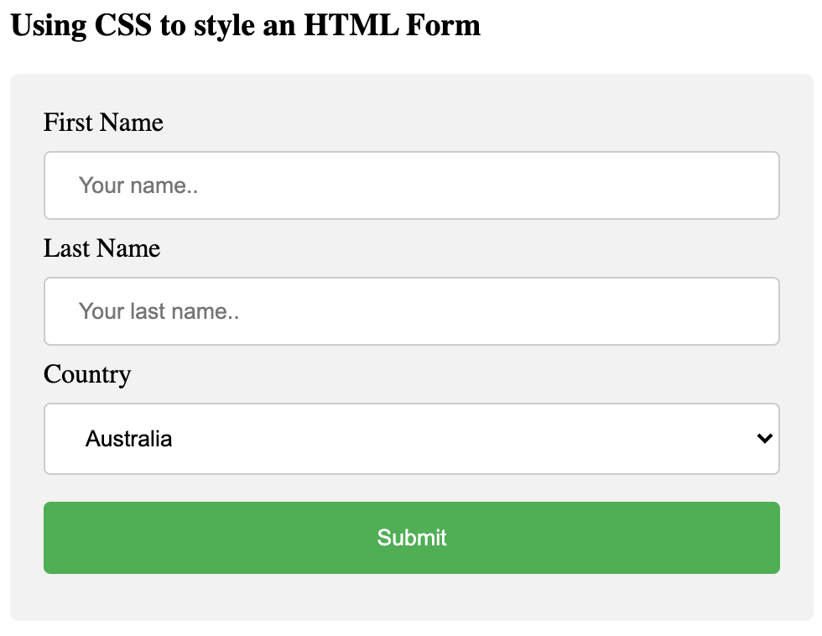
Code this webpage using HTML & CSS!
Please use the following tags:
<h3>
<div>
<form>
<label>
<input>
<select>
<option>
Notes:
https://www.w3schools.com/css/tryit.asp?filename=trycss_forms

Slide 30
JavaScript Exercise

Slide 31
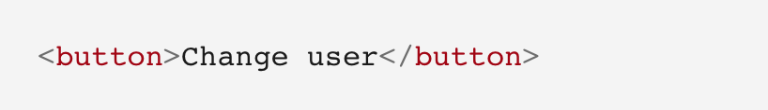
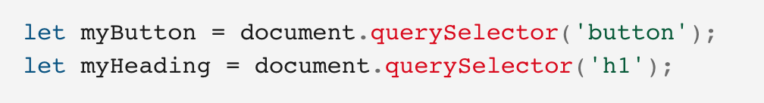
Personalized welcome message (JS)
1. In index.html, add the following line just before the <script> element:
2. In main.js, place the following code at the bottom of the file, exactly as it is written. This takes references to the new button and the heading, storing each inside variables:
Notes:
https://developer.mozilla.org/en-US/docs/Learn/Getting_started_with_the_web/JavaScript_basics

Slide 32
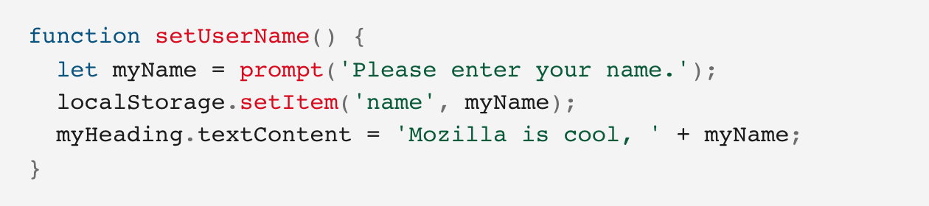
Personalized welcome message (JS)
3. Add the function below to set the personalized greeting. This won't do anything yet, but this will change soon.
Notes:
The setUserName() function contains a prompt() function, which displays a dialog box, similar to alert(). This prompt() function does more than alert(), asking the user to enter data, and storing it in a variable after the user clicks OK. In this case, we are asking the user to enter a name. Next, the code calls on an API localStorage, which allows us to store data in the browser and retrieve it later. We use localStorage's setItem() function to create and store a data item called 'name', setting its value to the myName variable which contains the user's entry for the name. Finally, we set the textContent of the heading to a string, plus the user's newly stored name.

Slide 33
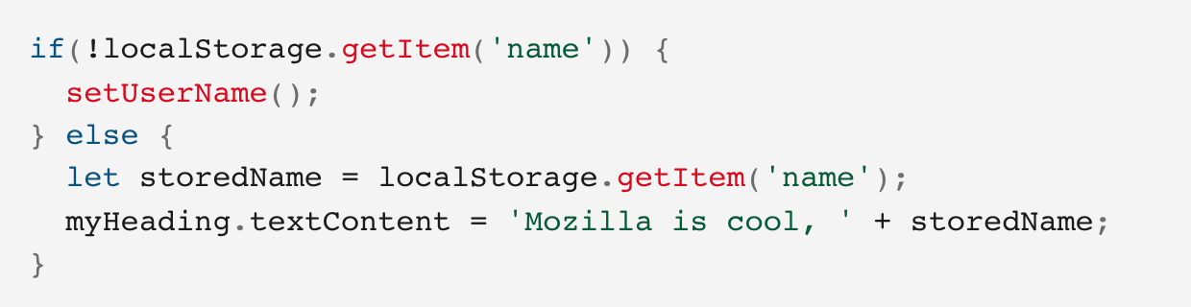
Personalized welcome message (JS)
4. Add the if ... else block (below). We could call this initialization code, as it structures the app when it first loads.
Notes:
This first line of this block uses the negation operator (logical NOT, represented by the !) to check whether the name data exists. If not, the setUserName() function runs to create it. If it exists (that is, the user set a user name during a previous visit), we retrieve the stored name using getItem() and set the textContent of the heading to a string, plus the user's name, as we did inside setUserName().

Slide 34
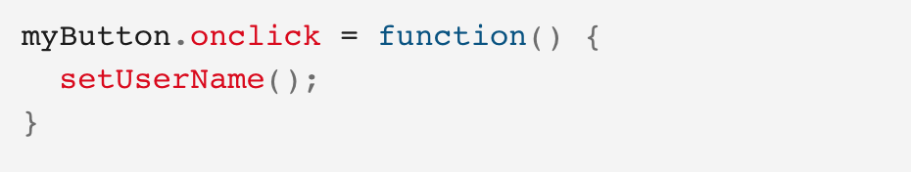
Personalized welcome message (JS)
5. Put this onclick event handler (below) on the button. When clicked, setUserName() runs. This allows the user to enter a different name by pressing the button.

